Slide 1
Create Multi-Platform Apps With .NET MAUI & the MAUI Community Toolkit Empowering .NET Developers for Cross-Platform Success
Alvin Ashcraft
Sr. Content Developer - Microsoft

Slide 2

Agenda
About Me: Speaker Introduction
Introduction to .NET MAUI and Cross-Platform App Development
Develop on Windows and macOS
Rapid App Building With XAML, C# & Visual Studio vNext
Enhance Apps with the .NET MAUI Community Toolkit
Simplify Your MVVM Architecture with the MVVM Toolkit
Build MAUI Apps with C# Markup in VS Code: No XAML Required
Style Apps With CSS in .NET MAUI (in JetBrains Rider)
Access Platform-Specific Features With .NET MAUI
Q&A: Your .NET MAUI Questions Answered
Notes:
We will cover an introduction to .NET MAUI, development tools, rapid app building techniques, enhancing apps with the MAUI Community Toolkit, architectural patterns like MVVM, styling options, platform-specific features, and conclude with a Q&A session.

Slide 3

About Me: Background and Expertise with .NET
Software industry for nearly 30 years
Started programming in 1995 (VB 3 & Microsoft Access)
Content developer at Microsoft since 2022
Morning Dew link blog
Daily links for .NET developers since 2007
Three (soon to be four) books for Packt Publishing
Learn WinUI 3 (two editions)
Parallel Programming and Concurrency with C# and .NET
MCP for .NET Developers (coming March 2026 - co-author)
TechBash dev conference organizer since 2016
Notes:
A little background about me…
For those who don’t know me, I’ve been in the software industry since 1995, with most of that time (over 25) years spent as a developer and architect using various Microsoft technologies.
Some of you may also be familiar with my blog, the Morning Dew, where I’ve been posting daily links for .NET developers since 2007.
I also have three books from Packt Publishing and I’m co-authoring a new book on Model Context Protocol for .NET developers. You can check those out on Packt’s website or on Amazon. Just search for my name.
Writing those books led me to pivot my career to technical writing. I joined Microsoft two years ago as a content developer. I write documentation, training modules, and code samples on Microsoft Learn. I work on the Windows developer docs team, helping to maintain the docs for client apps and APIs. I have another talk I give about my work as a content developer and how anyone can contribute to content on Learn through GitHub issues and PRs.
Finally, I’m one of the founding organizers of the TechBash developer conference. We’ve been running the event in the Poconos since 2016.

Slide 4
Introduction to .NET MAUI and Cross-Platform App Development
Notes:
This section introduces .NET MAUI, the platforms it supports, and why using a single codebase simplifies development for iOS, Android, macOS, and Windows.

Slide 5

Overview of .NET MAUI and Supported Platforms
Multi-platform Framework
.NET MAUI allows building apps for multiple platforms using a single shared codebase.
Supported Platforms
.NET MAUI supports Windows & macOS on the desktop and the iOS & Android mobile operating systems enabling cross-device compatibility for most app users today.
Notes:
.NET MAUI stands for Multi-platform App UI, enabling developers to build apps across major desktop and mobile platforms with one framework and codebase.

Slide 6
Benefits of a Single Codebase for iOS, Android, macOS, and Windows
Reduced Maintenance Effort
A single codebase simplifies updates and bug fixes, lowering the time and resources needed for maintenance.
Faster Development
Developers can build and deploy features faster by writing code once for all platforms.
Consistent User Experience
Using a unified codebase ensures users enjoy the same experience across devices and operating systems while still providing native performance and look & feel.
Notes:
A unified codebase reduces maintenance effort, speeds up development, and allows code reuse, making it easier to deliver consistent experiences across devices.

Slide 7

.NET MAUI vs Other Cross-Platform Other Frameworks
Language
.NET MAUI is an ideal choice for .NET developers. Frameworks like Flutter and React Native require other technical expertise.
Enhanced Performance
.NET MAUI offers enhanced performance, enabling faster and more efficient app execution compared to PWAs or React Native.
Community and Ecosystem
.NET MAUI puts Microsoft in your corner. Third-party libraries and controls are available but not required for building rich, performant apps. The .NET MAUI Community Toolkit and .NET Community Toolkit offer additional libraries supported by the open-source community.
Notes:
.NET MAUI improves upon Xamarin.Forms with better architecture, enhanced performance, and streamlined project structure, offering a more modern development experience.

Slide 8
Development Tools for Windows and macOS
Notes:
Explore the integrated development environments and tools available on Windows and macOS to build, debug, and deploy .NET MAUI applications efficiently.

Slide 9

Overview of Available IDEs and Tools
Primary IDEs
Visual Studio on Windows and VS Code on Windows and macOS serve as the main development environments for .NET MAUI development.
Supporting Tools
VS Code, GitHub Copilot, and CLI tools complement the primary IDEs by supporting flexible and lightweight development workflows. .NET MAUI Community Toolkit offers open-source controls and helpers for your apps.
Additional Options
JetBrains Rider supports .NET MAUI development on Windows and macOS.
Notes:
--- Visual Studio on Windows and macOS are primary IDEs, complemented by VS Code and command-line tools that support .NET MAUI development workflows. Image source: Microsoft 365 content library

Slide 10

Debugging and Building Across Platforms
Debugging Tools Usage
Use debugging tools like XAML Hot Reload, Live Visual Tree, and Visual Studio’s Binding Failures window to identify and fix issues effectively during development across platforms.
Simulators and Emulators
Simulators and emulators for Android and iOS replicate different platforms, enabling real-time testing without physical devices. Connect to a Mac from Visual Studio on Windows to debug iOS apps from your favorite IDE.
Notes:
--- Learn how to leverage debugging tools, simulators, and emulators to test applications on different platforms directly from your development environment. Image source: Microsoft 365 content library

Slide 11

Tips for Maximizing Productivity
Hot Reload Feature
XAML Hot Reload and .NET Hot Reload enable instant code and markup changes, speeding up development and reducing testing time.
Use of Templates
Templates provide reusable structures, enhancing consistency and saving time during coding.
Extensions for Quality
Visual Studio and VS Code extensions add functionality and help maintain high code quality across platforms.
Notes:
--- Utilize features like hot reload, templates, and extensions to speed up development and maintain high code quality across platforms. Image source: Microsoft 365 content library

Slide 12
Rapid App Building With XAML, C#, and Visual Studio
Notes:
This section covers setting up your environment and creating user interfaces using XAML and C# to build apps rapidly, even when using Visual Studio.

Slide 13

Setting up Your Development Environment
Essential SDK Installation
Install latest .NET SDK and required workloads to enable .NET MAUI app development on macOS or Windows.
Integrated Development Environments
Set up IDEs like Visual Studio or VS Code with relevant extensions for efficient coding.
VS Code extensions – Quick Demo
Tool Configuration
Configure development tools, extensions, and NuGet packages to streamline building and testing .NET MAUI applications.
Notes:
--- Configure your machine with necessary SDKs, IDEs, and tools to start building .NET MAUI apps, including installation of Visual Studio or VS Code extensions. Image source: Microsoft 365 content library

Slide 14

Building User Interfaces with XAML and C#
XAML for UI Design
XAML markup enables clear and declarative UI design for building flexible user interfaces.
C# Code-Behind Control
C# code-behind provides programmatic control to manage UI behavior and responsiveness dynamically.
Responsive and Maintainable UI
Combining XAML and C# results in responsive, flexible, and maintainable user interfaces.
Demo – Hello World in Visual Studio vs VS Code
Notes:
--- Understand how to design responsive and maintainable UIs using XAML markup and C# code-behind for flexibility and control. Image source: Microsoft 365 content library

Slide 15
Enhancing Apps With the .NET MAUI Community Toolkit
Notes:
Explore the powerful controls, extensions, and behaviors provided by the Community Toolkit to accelerate development and enhance app capabilities.

Slide 16

Overview of Controls, Extensions, and Behaviors
Reusable UI Components
Microsoft’s Community Toolkits provide reusable components that speed up UI development and maintain consistency.
Functionality Enhancements
Extensions, converters, and animations add new features that extend the capabilities of existing UI elements.
Improved Responsiveness
Behaviors improve app responsiveness by managing user interactions smoothly.
Demo - .NET MAUI Community Toolkit docs on Microsoft Learn
Notes:
--- The toolkit offers reusable components that simplify UI development, add new functionality, and improve app responsiveness. Image source: Microsoft 365 content library

Slide 17

Integrating Toolkit Features for Productive Development
Toolkit Controls & Extensions
Controls and extensions enhance development environments by adding useful features and functionalities.
Boost Productivity
Integrating the .NET MAUI Community Toolkit streamlines workflows and accelerates coding efficiency.
Demo – Using the Community Toolkit in your apps
Notes:
--- Learn how to incorporate toolkit extensions into your projects to boost productivity and maintain cleaner code. Image source: Microsoft 365 content library

Slide 18
Simplifying Architecture With the MVVM Pattern and MVVM Toolkit
Notes:
Understand the Model-View-ViewModel architectural pattern and how the MVVM Toolkit supports scalable and maintainable app architectures.

Slide 19
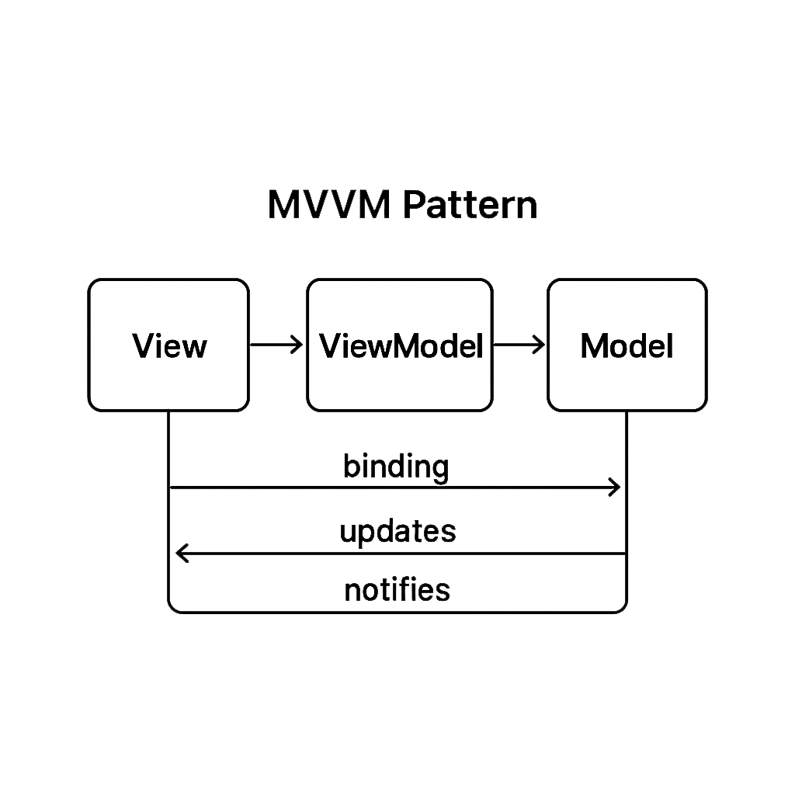
Introduction to MVVM in .NET MAUI
Separation of Concerns
Model-View-ViewModel (MVVM) clearly separates user interface from business logic for cleaner and modular code design.
Improved Code Organization
Using MVVM enhances code maintainability and organization in .NET MAUI applications.
Easier Testing
MVVM facilitates unit testing by isolating business logic from UI elements.
Notes:
--- MVVM separates UI from business logic, enabling better code organization and easier testing in .NET MAUI applications. Image source: Microsoft 365 content library

Slide 20

Leveraging the MVVM Toolkit to Reduce Boilerplate
Minimizing Repetitive Code
The MVVM Toolkit offers base classes designed to reduce repetitive coding tasks efficiently.
Streamlining Development
Helpers in the MVVM Toolkit streamline the development process, enhancing productivity and maintainability.
Notes:
--- The MVVM Toolkit provides base classes and helpers that minimize repetitive code and streamline development. Image source: Microsoft 365 content library

Slide 21

Best Practices for Scalable Cross-Platform Apps
Data Binding
Use data binding to synchronize UI and data models efficiently, enhancing app responsiveness and maintainability.
Command Patterns
Apply command patterns to encapsulate requests as objects, facilitating flexible and reusable code.
Dependency Injection
Use dependency injection to manage component dependencies, promoting modular and testable code architecture.
Demo – Use the MVVM Toolkit in Your Project
Notes:
--- Implement design principles such as data binding, command patterns, and dependency injection to build robust, scalable apps. Image source: Microsoft 365 content library

Slide 22
Building MAUI Apps With C# Markup: No XAML Required
Notes:
Explore an alternative approach to UI development using pure C# markup, offering advantages in flexibility and dynamic UI creation.

Slide 23
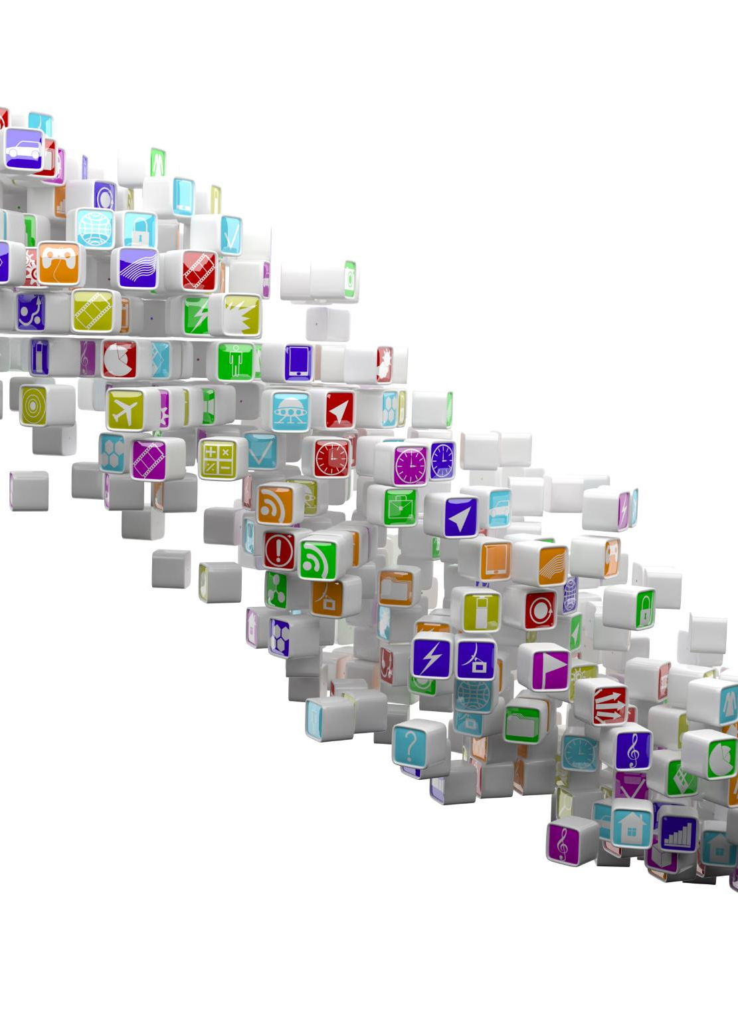
Advantages of Using C# Markup
Programmatic UI Creation
Developers can create and modify user interface elements using C# markup programmatically.
Improved Code Reuse
C# markup enhances code reuse by allowing modular UI components to be managed efficiently.
Reduced Context Switching
Using C# markup reduces context switching between design and code environments for developers.
Notes:
--- C# markup allows developers to create and modify UI elements programmatically, which can improve code reuse and reduce context switching. Image source: Microsoft 365 content library

Slide 24

Creating Dynamic UIs Purely in C#
Runtime UI Generation
Create user interface elements on-the-fly during application runtime using C# code for flexibility.
Enhanced Adaptability
Building UIs dynamically improves adaptability to complex and changing application requirements.
Pure C# Implementation
All UI components and logic are implemented purely in C# without relying on external tools or markup.
Notes:
--- Learn techniques to build user interfaces dynamically at runtime fully in C#, enhancing adaptability for complex scenarios. Image source: Microsoft 365 content library

Slide 25

Code Samples and Recommended Scenarios
Dynamic Layouts
C# markup enables flexible, dynamic layouts that adjust automatically based on data and user interactions.
Data-Driven UI Generation
UI elements can be generated dynamically from data sources, improving responsiveness and customization.
Demo – Create a Project with C# Markup
Notes:
--- Review practical examples where C# markup shines, such as dynamic layouts and scenarios where UI needs to be generated based on data. Image source: Microsoft 365 content library

Slide 26
Styling Apps With CSS and Web Style Reuse in .NET MAUI
Notes:
Discover how to leverage CSS for styling your apps, enabling reuse of existing web styles and ensuring consistent design across platforms.

Slide 27

Reusing Existing Web Skills
Leverage Web Development Skills
Utilize your existing web development knowledge to efficiently style MAUI applications.
Save Development Time
Reusing web assets reduces styling time, accelerating app development and deployment.
Maintain Brand Consistency
Consistent styling across web and MAUI apps ensures strong and uniform brand identity.
Notes:
--- Use your existing knowledge and assets from web development to style your MAUI apps, saving time and maintaining brand consistency. Image source: Microsoft 365 content library

Slide 28

Importing and Using CSS in MAUI Projects
Including CSS Files
Learn the process to import CSS files into a MAUI project to manage styles separately from code logic.
Applying Styles to Controls
Apply CSS styles effectively to UI controls for a clear separation between design and application logic.
Demo – CSS in .NET MAUI projects
Notes:
--- Learn how to include CSS files in your MAUI project and apply styles to controls to separate design from logic effectively. Image source: Microsoft 365 content library

Slide 29
Accessing Platform-Specific Features With .NET MAUI
Notes:
Learn how .NET MAUI abstracts device features, allowing you to access platform capabilities without writing separate platform-specific code.

Slide 30

Device Feature Abstraction in .NET MAUI
Unified API Access
.NET MAUI offers unified APIs simplifying device feature access across multiple device platforms.
Sensors Integration
APIs enable consistent access to device sensors like accelerometers and gyroscopes across platforms.
Camera and Storage
Support for camera usage and file management is streamlined via cross-platform APIs.
Demo – View the Device Platform docs
Notes:
--- .NET MAUI provides APIs that unify access to features like sensors, cameras, and notifications across platforms. Image source: Microsoft 365 content library

Slide 31
Q&A: Your .NET MAUI App Development Questions Answered
Notes:
This is your opportunity to ask questions related to .NET MAUI development, share feedback, and get additional resources to continue your learning journey.

Slide 32

Open Floor for Attendee Questions
Questions about .NET MAUI and the Community Toolkits?
General Cross-Platform Development Questions?
Notes:
--- Feel free to ask about any topics covered or other challenges you face in building cross-platform apps with .NET MAUI. Image source: Microsoft 365 content library

Slide 33

Sharing Additional Resources
Documentation Access
.NET MAUI docs home: https://learn.microsoft.com/dotnet/maui/
MAUI Toolkit docs: https://learn.microsoft.com/dotnet/communitytoolkit/maui/
Tutorials and Guides
Get started in docs: https://learn.microsoft.com/dotnet/maui/get-started/first-app
.NET MAUI learning path: https://learn.microsoft.com/training/paths/build-apps-with-dotnet-maui/
Community Groups
.NET MAUI Community Standup: https://www.youtube.com/watch?v=SeRGpBR3-3M&list=PLdo4fOcmZ0oX-sL7AFmygVw2A37Hbp8ZS
Sample Projects
Access sample projects to practice and apply new skills in real-world scenarios: https://github.com/dotnet/maui-samples
Notes:
--- Receive links to documentation, tutorials, community groups, and sample projects to deepen your understanding and skills. Image source: Microsoft 365 content library

Slide 34

Let’s Connect and Continue Learning
Leverage Social Media
Use social media platforms to connect with peers for sharing knowledge and support in .NET MAUI development.
Upcoming Events
Participate in community events to foster collaboration, learn new skills, and stay updated on .NET MAUI advancements.
Notes:
--- Let's stay connected through social media and community events for ongoing support and knowledge sharing in .NET MAUI development. Image source: Microsoft 365 content library

Slide 35
Conclusion
Thank you!
Notes:
We covered key aspects of building cross-platform apps with .NET MAUI and the Community Toolkit, from setup and architecture to styling and platform integration. Thank you for joining, and I encourage you to start building your own multi-platform applications today.

